Slide 1
Streamlined Modular Certification Kickoff [State] [System Name]
Module Type: [Spell out the module type]
Certification Manager: [CM Name]

Slide 2
Agenda
SMC Kickoff Purpose, Goals, and Timing
State and System Profile Review
What Is SMC?
SMC Touchpoints
SMC Milestones
APD and SMC Intake Form Relationship
SMC Elements
What to Expect: Operational Readiness Review (ORR)
What to Expect: Certification Review (CR)
Additional Information
Questions and Action Item Recap

Slide 3
SMC Kickoff Purpose, Goals, and Timing
Provide an overview of the Streamlined Modular Certification (SMC) process for Medicaid Enterprise Systems (MES).
Offer the state an opportunity to ask questions about the SMC process, outcomes, Conditions for Enhanced Funding (CEF), and metrics.
Ensure alignment on process expectations.
Gather core information necessary for certification.
Conduct the SMC kickoff at the project’s start because certification applies throughout the entire project lifecycle.

Slide 4
State and System Profile
Module Type: | [Specify the type of module]
System Name and Abbreviation: | [State's system name and abbreviation]
State Point of Contact: | [Name and contact information]
State Medicaid Director: | [Name and contact information]
UAT Completion Date: | [Date of User Acceptance Testing completion]
Go-live Date: | [Scheduled go-live date]
Vendors: | [List all vendors and sub-contractors involved]

Slide 5
What Is SMC?
SMC is the required procedure for states to achieve certification for specific modules in their Medicaid Enterprise System. ​
Under 42 CFR §433.116, SMC is the mechanism for states to gain approval for enhanced Federal Financial Participation (FFP), which enables a 75% funding rate for certified systems once CMS conditions are met.​
Ensures compliance with key statutory and regulatory requirements.

Slide 6
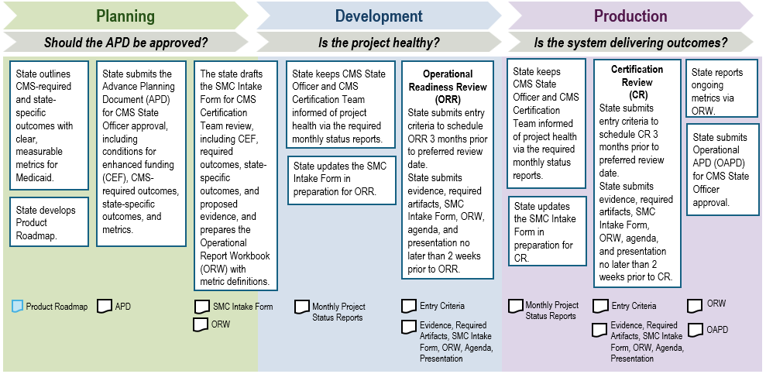
SMC Touchpoints
These are the three IT lifecycle phases (DDI to operations). The unshaded boxes are the SMC touchpoints.
Notes:
The SMC process consists of three phases and is independent of the state system implementation lifecycle methodology:
1) The Planning phase: When the state is in the planning phase of a project, the state develops the initial intended outcomes desired of the new module and works with CMS to refine them.
2) The Development phase: When the state and the vendor are in the Design, Development, and Implementation (DDI) phase the state works with CMS to prepare for the Operational Readiness Review (ORR).
3) The Production phase: When the module is live, the state works with CMS to prepare for the final CR.
The detail on the bottom of the diagram is the output from that phase. It is CMS’ expectation that the SMA will be able to reuse the files they have already received and reviewed from their IT investment as part of the ongoing system acceptance process. Said another way, CMS anticipates the state leveraging reuse of preexisting documentation already required by the state for the project, ultimately reducing or eliminating the additional effort associated with “evidence curation” for SMC.
Technical Assistance is provided throughout entire process. For example, ask the CMS Certification Team for a review of the draft SMC Intake Form, along with metrics, including after production prior to CR.

Slide 7

SMC Milestones
Operational Readiness Review (ORR)
Certification Review (CR)
Operational Metric Reporting
At the end of the Development Phase and after all testing is complete, states undergo an ORR prior to releasing their system into production.
A CR can be conducted once a system has been in production for at least six months and the state must report on approved metrics retroactive to the state's go-live date.
Once a system is certified, a state must continue to submit metric data in the CMS Box Metrics folder and with OAPD submission.

Slide 8
APD and SMC Intake Form Relationship
APD (Advanced Planning Document):
Starting point for certification
Includes CMS-required and state-specific outcomes
Defines metrics
SMC Intake Form:
Drafted using the approved APD
Includes explanations for non-applicable CEFs and outcomes
Proposes evidence for applicable CEFs and outcomes
Lists approved metrics matching the APD
Process:
APD approved and SMC Intake Form drafted
Use and update the SMC Intake Form throughout the certification process
For agile or phased implementation, the state must map phases to outcomes to assist the CMS Certification Team in determining ORR and CR dates

Slide 9
SMC Elements
The SMC process consists of the following elements:
Conditions for Enhanced Funding
CMS-Required Outcomes
State-Specific Outcomes
Metrics

Slide 10
Conditions for Enhanced Funding
Identify Applicable CEF:
Determine which CEF apply to the system
Provide detailed explanations for non-applicable CEF in ORR and CR columns in the SMC Intake Form
Attest to Compliance:
State must attest that the system complies with all applicable CEF as per 42 CFR §433.112
Ensure ongoing compliance with Medicaid program standards, laws, and regulations
Provide Evidence and Documentation:
CEF do not require demonstrations
Reference the MES Certification Repository for CEF examples, required evidence, and corresponding metric.

Slide 11
CMS-Required Outcomes
Based on statutory or regulatory requirements
Ensure efficient, economical, and effective Medicaid program administration
Should be treated as requirements
SMC Intake Form:
List all CMS-required outcomes for the specific module type(s) in the SMC Intake Form
Provide explanations for non-applicable outcomes in ORR and CR columns
Refer to the MES Certification Repository for a complete list of CMS-required outcomes

Slide 12
State-Specific Outcomes
Address improvements not covered by CMS-required outcomes
Reflect unique state circumstances
Specific to the state’s IT investment
Demonstrate progress toward state goals and show benefit to the Medicaid program

Slide 13
Metrics
Importance:
Enhance transparency and accountability of IT solutions
Provide early insight into program evaluation and opportunities for improvement
Requirements:
Report system performance metrics as a condition for enhanced funding (42 CFR §433.112(b)(15))
Submit metrics in the appropriate certification folder in CMS Box
Continue reporting metrics from go-live and throughout the system's lifecycle in the appropriate metric folder in CMS Box, along with including it with the OAPD submission
Updates:
Metrics and outcomes may change over the course of the project due to program needs or other changes
Discuss updates with the CMS State Officer and submit an APD-Update if necessary

Slide 14
What to Expect: Operational Readiness Review (ORR)

Slide 15
About the ORR
Purpose
Review state’s design and development experience
Confirm system readiness for production
Ensure likelihood of achieving described outcomes and metrics
Eligibility
CMS Certification Team will confirm date once state has met the entry criteria
Timing
Conducted before the project goes into production
Demonstrations
Executed in the state’s preproduction (testing) environment

Slide 16
ORR Timeline
Date for ORR will be confirmed up to 3 months in advance, dependent on completion of entry criteria
State receives Information Request Listing (IRL) for any additional clarification needed
System goes live
State prepares for Certification Review
3 months prior
2 weeks prior
1 week prior
Date of ORR
1 week after
State submits all files
State receives Tear-out and SMC Intake Form with feedback
State begins collection of metrics data in production
Notes:
For the ORR, the following steps are completed:
1. Confirming the review date requires completion of entry criteria and all files must be submitted 2 weeks prior to the confirmed date. “All files” includes Evidence, Required Artifacts, SMC Intake Form, Operational Report Workbook (ORW), Agenda, Presentation.
It is important to distinguish between required artifacts and evidence. Evidence is documentation or data that proves the achievement of an outcome, as listed in the SMC Intake Form on the Outcomes and Metrics tab. Required Artifacts, on the other hand, are documents that demonstrate the progression of a state’s project and are not typically used as evidence for outcomes.
2. Preferably, earlier but no later than two weeks before the ORR, the state uploads all evidence, required artifacts, the Intake Form, Operational Report Workbook, the ORR agenda, and the presentation in the appropriate CMS Box certification folders (see Using Box).
o The state notifies the CMS Certification Team when they have completed loading all documentation (no later than 2 weeks prior to the review date).
o The CMS Certification Team will then begin a review and draft the Information Request Listing (IRL).
3. Approximately one week prior to the review, an IRL will be sent to the state by the CMS Certification Team. This includes questions and feedback on the files uploaded to the CMS Box. Although providing written responses to these questions before the review is encouraged to streamline the review, it is not mandatory. The state must be prepared to address all outstanding questions from the IRL during the review discussions and demonstrations.
4. The ORR meeting is held, and action items are documented, reviewed, and agreed to.
5. A Tear-out will be created by the CMS Certification Team including observations, recommendations, and action items. The Tear-out will be sent to the state along with an updated Intake Form (with CMS columns filled out) approximately one week after the ORR meeting.
6. The Tear-out observations and recommendations should be reviewed, and action should be taken as necessary, as the state’s response will need to be reviewed during the CR.

Slide 17
ORR Entry Criteria (1 of 2)
* On the first day of each month, the review calendar opens for the upcoming three months, inclusive of that month.
Prior to requesting to schedule an ORR, the state must provide the following information:
Go-live Date:
Provide anticipated go-live date with defined go/no-go exit criteria and the decision date
User Acceptance Testing (UAT):
Submit timeline for UAT completion
Latest SMC Intake Form:
Provide a draft, finalized two weeks before the review
Ensure all CMS-required outcomes and CEF items are included; if any are N/A, provide a justification.

Slide 18
ORR Entry Criteria (2 of 2)
* On the first day of each month, the review calendar opens for the upcoming three months, inclusive of that month.
The following files or a projected timeline for completion:
Security and privacy controls assessment report (SAR) and penetration test results:
Provide the independent, third-party SAR and penetration test results conducted within the last two years from the requested ORR date
Provide Authority to Connect (ATC) letter, if applicable
Plan of Action & Milestones (POA&M):
Provide the most recent status of vulnerabilities regardless of risk level (from SAR, penetration tests, vulnerability scans, disaster recovery test results)
Resolve critical findings prior to requesting to schedule a review (or provide risk acceptance)
CMS Box Link:
CMS State Officer: access; CMS Certification Team: folder setup
Note: Meeting the entry criteria allows for ORR scheduling; the state must submit up-to-date documents to the applicable certification Box folder two weeks before ORR for evaluation by the CMS Certification Team.
Notes:
All critical vulnerabilities should be resolved prior to scheduling a review date. However, states can request a date with unresolved critical items if a mitigation/remediation plan is submitted using the recommended risk acceptance template, which can be found in Attachment D of CMS Information Security Plan of Action and Milestones (POA&M) Procedure.

Slide 19
Preparing for the ORR
Submit draft agenda and presentation slide deck with all certification files two weeks before ORR.
Finalize agenda and slides one week before ORR.
Respond to the Information Request Listing (IRL) at least 2 days before the meeting to streamline discussion; otherwise, address each question during the review.
Ensure attendance from applicable SMEs (including privacy and security) to respond to the CMS Certification Team’s questions, which could include additional demonstrations in the system.
CMS will allow redaction of sensitive information (e.g., IP addresses and hostnames). However, all other information, including network architecture, is required to support the certification decision.
Notes:
“All files” includes Evidence, Required Artifacts, SMC Intake Form, Operational Report Workbook (ORW) with metric definitions, Agenda, Presentation.

Slide 20
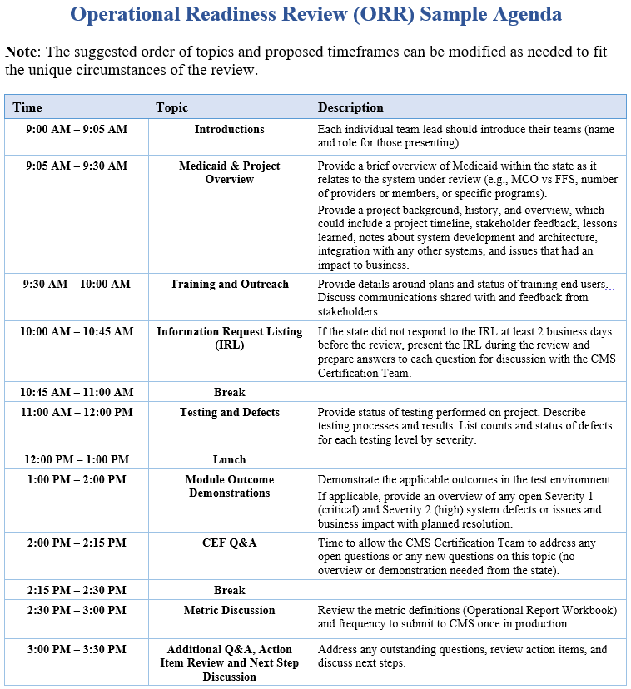
Sample ORR Agenda
Notes:
CMS Certification Team will send the sample agenda templates after the call as requested; these are also located on MES Certification Repository. States should stick to the structure as best possible but will have some flexibility to update where needed and can put in their own template if desired.

Slide 21
Post ORR
Complete ORR Tear-out action items by the due dates agreed on during the review.
System will go live.
Begin collecting metrics data starting from the go-live date.
Review and address SMC Intake Form and Tear-out observations/recommendations and provide updates to CMS before or at the time of the Certification Review (CR).
Complete entry criteria for CR scheduling, preferably three months before the intended CR date.
Use the SMC Guidance to prepare for the CR.
To be certified, system must have been operational for at least 6 months and state must submit data for the duration of the period for which it was operational and in compliance with all certification requirements.

Slide 22
What to Expect: Certification Review (CR)

Slide 23
About the CR
Purpose:
Assess the impact of system functionality in production
Evaluate metrics to demonstrate outcomes and compliance
Eligibility:
CMS Certification Team will confirm date once state has met the entry criteria
Timing:
Earliest CR can occur is in the 7th month post go-live (for six months of metrics)
Demonstrations:
Conducted in the state’s production environment
Notes:
After go-live and before CR, states should upload ORWs to their certification CR folder. They may also upload them to their State Submission folder, but we recommend waiting. This allows time to address any changes, or ingestion issues the Certification Team may identify before placing copies in the State Submission folder.

Slide 24
CR Timeline
Date for CR will be confirmed up to 3 months in advance, dependent on completion of entry criteria
State receives Information
Request Listing (IRL) for any additional clarification needed
State receives final CR package which includes the report, adjudicated SMC Intake Form, and decision letter
State submits the Operational APD (OAPD) for CMS approval
3 months prior
2 weeks prior
1 week prior
Date of CR
1 day after
NLT 60 days after
Ongoing
State submits all files
State receives action item list
State submits metrics regularly via the Operational Report Workbook
Notes:
For the CR, the following steps are completed:
1. Like the timeline for ORR, confirming the date requires completion of entry criteria and all files must be submitted 2 weeks prior to the confirmed date. “All files” includes Evidence, Required Artifacts, SMC Intake Form, Operational Report Workbook (ORW), Agenda, Presentation.
It is important to distinguish between required artifacts and evidence. Evidence is documentation or data that proves the achievement of an outcome, as listed in the SMC Intake Form on the Outcomes and Metrics tab. Required Artifacts, on the other hand, are documents that demonstrate the progression of a state’s project and are not typically used as evidence for outcomes.
2. Preferably, earlier but no later than two weeks before the CR, the state uploads all evidence, required artifacts, the Intake Form, Operational Report Workbook, the CR agenda, and the presentation in the appropriate CMS Box certification folders (see Using Box).
o The state notifies the CMS Certification Team when they have completed loading all documentation (no later than 2 weeks prior to the review date).
o The CMS Certification Team will then begin a review of the evidence and required artifacts.
3. Approximately one week prior to the review, an IRL will be sent to the state by the CMS Certification Team. This includes questions and feedback on the files uploaded to the CMS Box. Although providing written responses to these questions before the review is encouraged to streamline the review, it is not mandatory. The state must be prepared to address all outstanding questions from the IRL during the review discussions and demonstrations.
4. The CR meeting is held, and action items are documented, reviewed, and agreed to.
o The demonstrations must be in the production environment (test data should not be entered).
o The state should try to respond to all action items as soon as possible, preferably within 24 hours.
5. After the CR, CMS Certification Team will review and enter comments into the Intake Form and assemble the certification package. CMS will follow up with the state to discuss any necessary request for additional information. Once certification is approved, the state will receive the updated Intake Form, the certification report, and the certification decision letter from CMS.

Slide 25
CR Entry Criteria (1 of 3)
* On the first day of each month, the review calendar opens for the upcoming three months, inclusive of that month.
Prior to scheduling a Certification Review (CR), the state must provide:
Latest SMC Intake Form:
Provide a draft, finalized two weeks before the review
Metric Data:
Submit data from go-live date to the most recent month end
Security and privacy controls assessment report (SAR) and penetration test results:
Provide the independent, third-party SAR and penetration test results conducted within the last two years from the requested CR date
Provide Authority to Connect (ATC) letter, if applicable

Slide 26
CR Entry Criteria (2 of 3)
* On the first day of each month, the review calendar opens for the upcoming three months, inclusive of that month.
Plan of Action & Milestones (POA&M):
Provide the most recent status of vulnerabilities regardless of risk level (from SAR, penetration tests, vulnerability scans, disaster recovery test results)
Resolve critical findings before requesting CR (or provide CMS approved risk acceptance)
CMS Box Link:
CMS State Officer: access; CMS Certification Team: folder setup
T-MSIS OBA Compliance:
CMS State Officer will confirm Outcomes Based Assessment (OBA) with CMS T-MSIS team
Notes:
All critical vulnerabilities should be resolved prior to scheduling a CR date. However, states can request a date with unresolved critical items if a mitigation/remediation plan is submitted and approved by CMS, using the recommended risk acceptance template, which can be found in Attachment D of CMS Information Security Plan of Action and Milestones (POA&M) Procedure.

Slide 27
CR Entry Criteria (3 of 3)
* On the first day of each month, the review calendar opens for the upcoming three months, inclusive of that month.
Once prior files are approved, the state should provide the Certification Request Letter:
The letter should align with the example template posted on the MES Certification Repository
Attach System Acceptance Letter with acceptance and go-live dates
Send the Certification Request Letter and applicable attachments via email to the MES.Certification@cms.hhs.gov
Upload the two letters to the applicable certification Box folders
Note: Meeting the entry criteria allows for CR scheduling; the state must submit up-to-date documents to the applicable certification Box folder two weeks before CR for evaluation by the CMS Certification Team.
Notes:
Certification Request Letter FAQs from MES Certification Repository:
Q: What date should the state put in the Certification Request Letter?
A: The state should use the go-live date as the retroactive date in the Certification Request Letter, unless there was a system issue, then use the date the issue was resolved and include a brief description of the issue in the letter.
Q: What is the retroactive date for claiming the 75% Federal Financial Participation (FFP) rate once a system is certified?
A: Per 42 CFR 433.116(a), the 75% FFP rate begins retroactively on the first day of the calendar quarter following the system’s implementation date. For example, if a system goes live on February 1, 2025, and CMS approves certification back to that date, the state can claim the 75% FFP rate starting April 1, 2025.
The enhanced DDI rate (90/10) applies up to the implementation (go-live) date.(February 1, 2025 in this example).
After implementation, any months remaining in that calendar quarter are claimed at the 50% FFP rate (February-March 2025 in this example).
The enhanced M&O rate (75/25) starts on the first day of the calendar quarter following the retroactive certification approval date (April 1, 2025 in this example).
States are encouraged to implement in the last month of a calendar quarter.

Slide 28
Preparing for the CR
Submit draft agenda and presentation slide deck with all certification files two weeks before CR.
Finalize agenda and slides one week before CR.
Respond to the Information Request Listing (IRL) at least 2 days before the meeting to streamline discussion; otherwise, address each question during the review.
Ensure attendance from applicable SMEs (including privacy and security) to respond to the CMS Certification Team’s questions, which could include additional demonstrations in the system.
CMS will allow redaction of sensitive information (e.g., IP addresses and hostnames). However, all other information, including network architecture, is required to support the certification decision.
Notes:
“All files” includes Evidence, Required Artifacts, SMC Intake Form, Operational Report Workbook (ORW)-with values back to go-live, Agenda, Presentation.

Slide 29
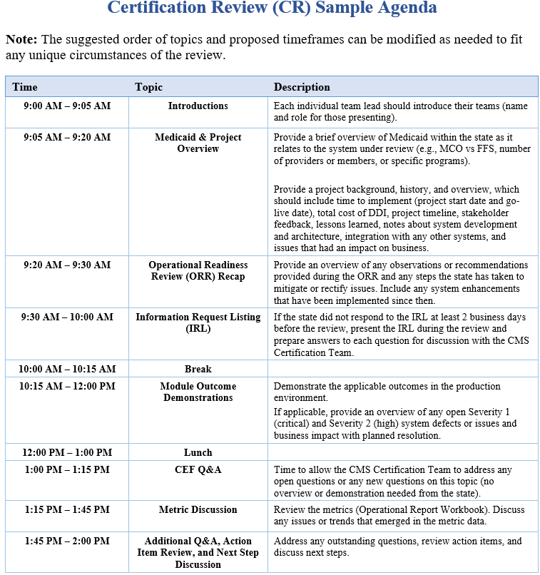
Sample CR Agenda
Notes:
CMS Certification Team will send the sample agenda templates after the call as requested. States should stick to the structure as best possible but will have some flexibility to update where needed and can put in their own template if desired.

Slide 30
Post CR
State receives feedback and official certification documentation.
CMS will follow up with the state shortly after the CR to discuss any concerns, as applicable
CMS will comment on the review in the final CR report returned to the state, along with a formal Certification Decision Letter
State will address any observations and recommendations
After approval, continue working with State Officer.
State will report metrics regularly via recommended Operational Report Workbook
State will submit the Operational APD (OAPD) for CMS State Officer approval

Slide 31
MES Certification Repository
CMS Certification Team will demo the MES Certification Repository during the kickoff.

Slide 32
Additional Information
SMC Guidance:
Available on Medicaid.gov (and GitHub): https://www.medicaid.gov/medicaid/data-systems/certification/streamlined-modular-certification/index.html
MES Certification Repository:
Used to share additional information with states to supplement the SMC Guidance.
Hosted on GitHub: https://cmsgov.github.io/CMCS-DSG-DSS-Certification/
Resources in the MES Certification Repository:
Conditions for Enhanced Funding examples and required evidence and CEF Tips
Using the SMC Intake Form
Using Box
Frequently Asked Questions
MES Testing Guidance Framework:
Available on Medicaid.gov: https://www.medicaid.gov/medicaid/data-and-systems/downloads/mes-testing-guidance-framework.pdf

Slide 33

Questions and Action Item Recap

